Slide 1

CA22123 EU-MACE: Core Group monthly update GP2 #1
Virtual
12/11/2024

Slide 2
meeting Agenda
Today’ meeting is recorded!

Slide 3
0. Ice breaker
GP1
PR1 report
Recent Actions
Financial report and budget
GP2
Work and budget plan
WG leader and task leader position mandate
MC approval steps
MC1 meeting in Feb 2025
Tasks
MAP and Expert list update
Extra details to accompany the presentation
Next Action monthly update meetings
AOB
1AAC presentations

Slide 4
GP1 summary

Slide 5
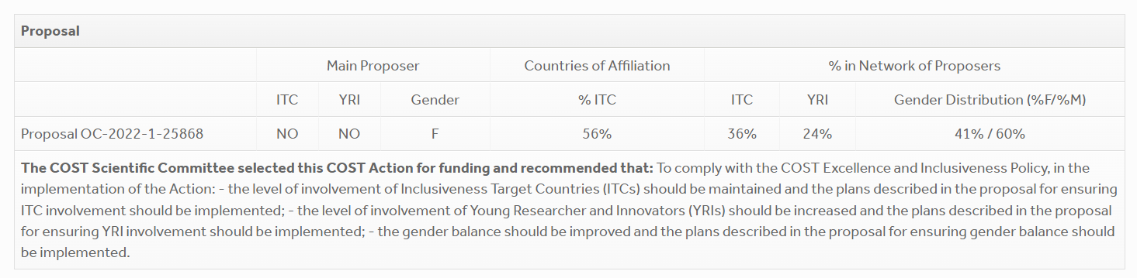
PR1 report
Progress report for GP1: state of play in 2022 (proposal submission)

Slide 6
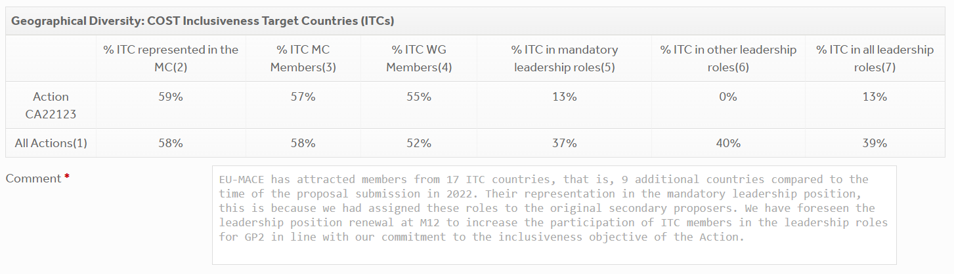
PR1 report
Progress report: geographical diversity

Slide 7
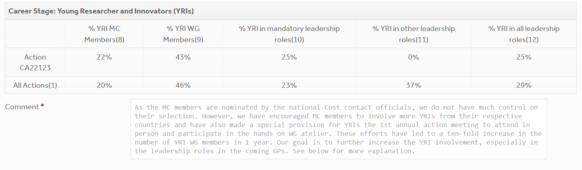
PR1 report
Progress report: Career stage (YRI)

Slide 8
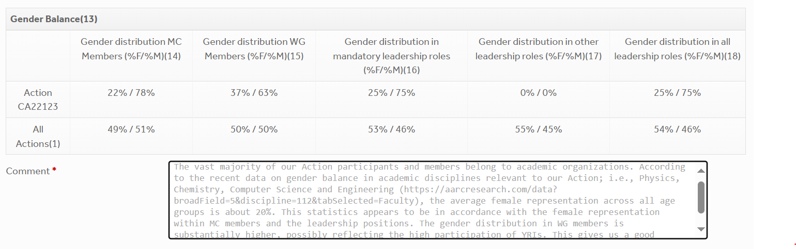
PR1 report
Progress report: Gender balance

Slide 9
PR1 report
Comment on Action’s implementation:
ITC involvement to be maintained: The percentage of ITC members have increased from 37% to 55% since the time of the project submission/selection phase.
YRI involvement to be increased: The percentage of ITC members have increased from 25% to 45% since the time of the project submission/selection phase. This, in part, owes to our effotr encouraging the MC and non-MC members to involve YRIs within their groups to present their work at the workshop (held in January 2024) and inviting their in-person participation at the 1st Action Annual conference (September 2024).
Gender balance to be improved: The gender balance has been the most difficult aspect despite our effort to invite female members' participation at the different activities of our Action. There are several tasks which are headed by female members that are not formalized. Their contributions to the Action shall be recognized.

Slide 10
PR1 report
Describe Action’s plans to implement:
ITC involvement to be maintained: In order to increase the role of ITC members within the leadership roles, the Action has foreseen the selection of new WG and task leaders at the beginning of the GP2.
YRI involvement to be increased: In addition to the bespoke leadership renewal, we shall create a new role/task "Young EU-MACE" whose purpose is to organize webinars featuring YRI's scientific work to be presented to the Action community.
Gender balance to be improved: Action's transversal tasks such as 'website & social media' and 'ERASMUS incubation' which are headed by female researchers will be formally recognized as leadership roles. Other mandatory leadership roles will also be replaced by female members.
To be discussed later today

Slide 11
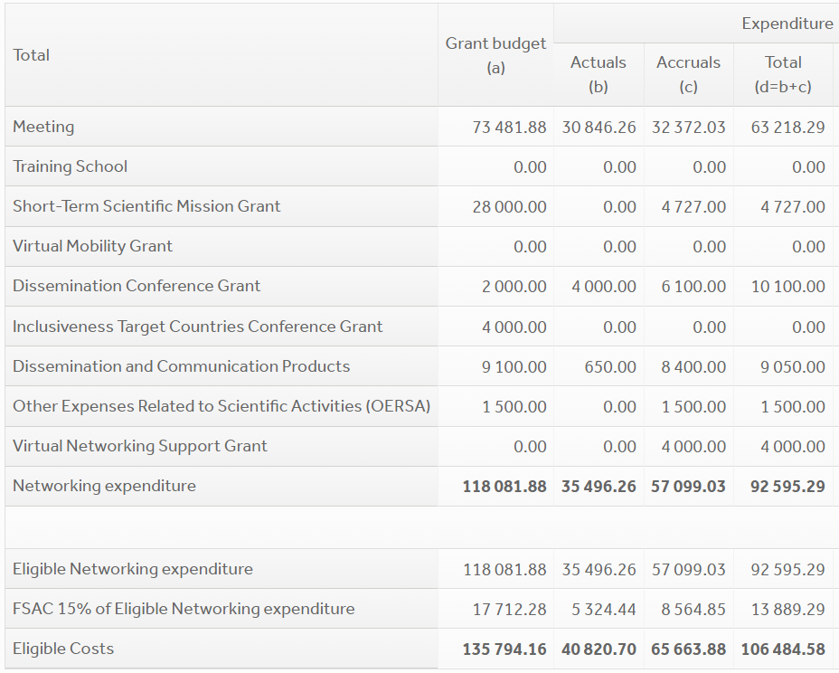
Financial reporting
1 MC + Workshop in Jan 2024
1st AAC in Sept. 2024
2 STSMs to BAM
6 DCGs
No YRI CG granted – all out of scope, or out of time
Web & logo creation + maintenance
Roll-up banner
Searchable MAP & Expert list via ChainMap
We will do better next year by early planning

Slide 12
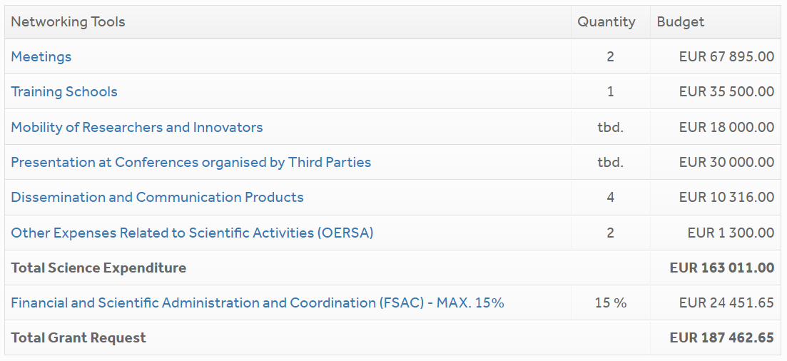
Budget plans
BP submitted to COST Action verification
1 MC/WG meeting in Feb 2025
1 Workshop, September 14, EUROMAT 2025
TOTEMIC, April 20-26, 2025, 10 lecturers and 15 participants via lump-sum daily allowance + travel support
STSM – research & education
ICT, YRI conference grants
Dissemination conference grants
Web maintenance
Promotional video
Flyers & dissemination materials
Booth at Future Labs Live 2025 (May)
Bank charges
Training school cosumables
We will do better next year by early planning !!

Slide 13
Future actions

Slide 14
WG & Task leader mandate
In MC1 meeting, we have decided to change WG/Task leaders (if needed) @M12 AND we must increase the participation of ICT, young & female members participation
WGs & Task | current | Next GP
WG1 – perovskites | Helge Stein (DE) | ?? – discussion foreseen later this afternoon
WG2 – metallic alloys | Jarek Jasinski (PL) | Jarek Jasinski (PL) – on going activity
WG3 – New materials | Kourosh Malek (DE) | Kourosh Malek (DE) – on going activity
WG4 - training | David Lacroix (FR) | D. Lacroix until May 2025 ➔ new leader (Antonio?)
WG5/Communications | I. Matejak (BE) | Gloria Botton (BE, YRI)
Grant Award committee | Holger Ihssen (DE) | Peter, Antonio, Tugba ??
Sustainability | G. Campana (IT) | Giampaolo Campana – just started new activity
Inter-COST Action actions | Saco Nakamae (AC/FR) | Anyone ??
Young EU-MACE | New | Anyone ??
Erasmus incubation | Theodora Kyratsi (CY) | ??
MAP & EXP List/database | Kourosh Malek (DE) | Kourosh Malek (DE) & Ioisif Galanakis
Legacy Labs | New | Ozlem & Dorottya, Sandra, Jasna
Other new tasks/leader roles? | Industrial partnership? | To be discussed
Notes:
Ozlem: legacy lab through dataflow. For automation it’s good to have less advanced

Slide 15
B2B platform for MAP & Expert list
EU-MACE B2B ecosystem intelligence platform now online: link under ‘tools-resources’ menu
Created by Kourosh Malek
Maintenance team
Gloria Botton (comm., EERA, BE)
Iosif Galanakis (MC, Greece)
Sawako Nakamae AC
Monica Fabrizio VC

Slide 16
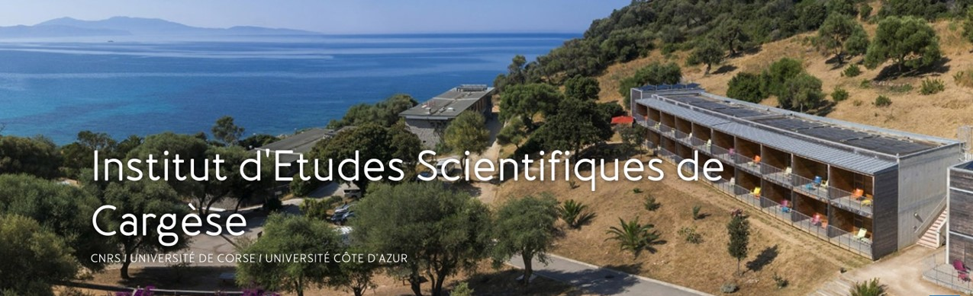
TOTEMIC 2025 training school
Tools for Energy Materials Modelling Acceleration Training school: confirmed late October!
April 20 – 26, 2025
Cargèse, Corsica, France
Joint organization with CNRS (France) GdR NAME
Co-chair from EU-MACE : David Lacroix
12 confirmed speakers
Material for energy ; added value of IA (application field : battery, fuel cell, catalysis, carbon capture, etc.).
Nano & micro material design for tailored properties; advantages of using high throughput and screening techniques.
Machine learning driving sustainable material development (life cycle, critical materials, material reliability, ageing, in operando behavior, etc.)
AI tools and material acceleration platforms; how embed data (operability/readability/etc.) to improve experimental research
Material informatics ; AI techniques devoted to multiscale, from the material to the system

Slide 17
TOTEMIC 2025 training school
Structure and EU-MACE participation
50 – 80 attendees
10 invited lecturers (covered by EU-MACE)
15 invited students/YRIs (covered by EU-MACE)
720€/person (to be determined) accomodation fee covers lodging and food
Travel cost according to one’s needs (~700€/person)
Announcement and the first call of abstracts to appear in November
Lecturers from EU-MACE
Scientific committee from EU-MACE
David Lacroix
Sawako Nakamae
Antonio P. Goncalves
Rafael Mayo Garcia
Roberto Iglesias
Theodora Kyratsi
Theodore Karakasidis
Janne Pakarinen
Monica Fabrizio
Iosif Galanakis
Michael Eikerling (Aachen) – plenary lecture
Kevin Rossi (Delft)
Ozlem Ozcan (BAM)
Kathy Christofidou (Royce)
David Lacroix <david.lacroix@univ-lorraine.fr>

Slide 18

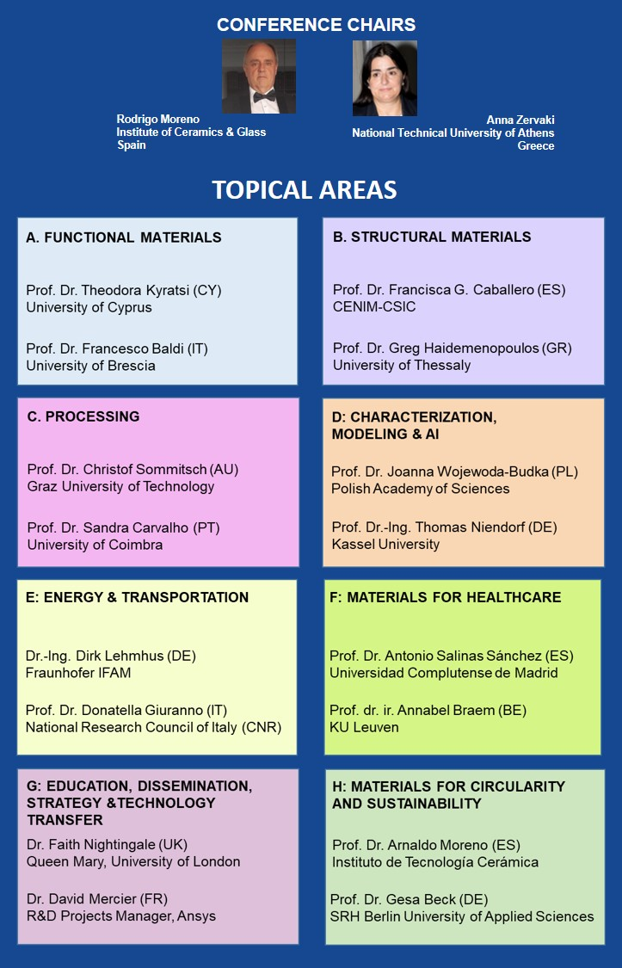


Notes:
18

Slide 19
EUROMAT 2025
Topics, organization, etc.
50 – 80 attendees (hybrid)
September 14, 2025
Registration is independent from EUROMAT
Can support ~20-25 attendees for the forum (but NOT the conference)
Special provision for 5-10 YRI’s conference grants (max 2000€ each)
Topics ➔
Organization committee from EU-MACE
Theodora Kyratsi
Antonio P Sanjuan (local organizer)
Jaroslaw Jasinksi
Monica Fabrizio
Holger Ihssen
Sawako Nakamae
Erika Hodulova
Accelerated device integration: by unifying digital and materials competency (Increasing SDLs & MAPs capacities via horizontal collaborations)
Continued growth (Further education). Adapting one’s ‘traditional’ training to the fast-changing dynamics toward the digital-driven and holistic research approach is a formidable challenge faced by many senior investigators.

Slide 20
details on forum topics
Topics, audience and stakeholders at EUROMAT 2025
Accelerated device integration : How do advanced, functional (new or improved) materials find their way into technology?
Stake holders:
SMEs specialized in prototyping : how to find such companies? How do they design, build and validate prototypes? What are the following stages in the innovation chain?
Digital twin specialists (overlap with point i above): who are they? How to contact them?
Funding sources: Device development costs money. Who invests money into this innovation step? Public and private funding schemes, where to find venture capitalists and what are the key criteria they use to determine in which materials/devices to invest/fund?
Audience: researchers, educators, students, industries
Continued growth (Further education): How to liaise local, isolated experimental/numerical practice to MAPs?
Stake holders:
Energy materials researchers whose methodologies do not include automation, AI assisted analysis/simulation, high-throughput characterization, or sustainability analysis… etc.
Automation specialists, ML software developer, LCA scientists
SMEs who want to assist in building prototypes, or benefit from Action partner labs
Can be made into a project matchmaking session that participants sign up beforehand to present their R&D ambitions

Slide 21
details on forum topics
Proposition from EuMINe & DAEMON (contacted on November 7th)
Co-organization of the forum/session:
Questions:
Forum or Session? (co-location or co-organization event)
Which scientific theme? (they are both modelling and data centered Actions)
Resource Sharing?
Meeting scheduled on Thursday Nov 17 ➔ Nov 22!
Will keep you posted.
Check out « euromat2025.com »! Abstract submission is open
Encourage young researchers from your group to attend (the conference)
Conference grant guidelines will remain similar
Acceleration aspect
STSM results

Slide 22
Future Labs Live – Basel
27-28 May, 2025 (terrapin.com/conference/future-labs-live/index.stm)
What is it: Diverse, stimulating, and exciting event for the future of all labs. Areas of technology: Biotech, Pharma, Chemicals, Food & Beverage, Agricultural, Materials… to pave the way and share their experiences and vision for the lab of the future.
Exhibition Booth & speaker slots:
Stake holders: Start-ups, disruptors and innovators from academia in bespoke areas.
What we present: EU-MACE and our member labs! Brochures, Demos, videos,
Funding:
Booth space
Travel & DA via DC grants
Contents:
What: Discussion with the organizer this Friday (Nov. 18th)
Who is interested in showcasing your lab?
1-2 in person attendance (should become a speaker, too)
Dissemination material distribution
If interested, PLEASE email me after Nov 18th before Dec. 18th!!

Slide 23
Next meetings/discussions
Action monthly meeting: THURSDAY December 12, 2024 (NOT ON Tuesday!)
If interested in the leadership positions, please email me and state your contribution propositions
New leadership candidates will be presented
Finalized work and budget plan presentation
MC meeting: (late) January or (early) February 2025 – in person, 1.5 days (WG3/Task meetings) WHERE?
New leader presentation
New actions (YRI webinar plans, Training school, EUROMAT, futre Lab Live)
WG3? and Sustainability?
If no candidate location appears, the meeting will take place in Paris.
Please contact me before Dec. 1st
The dates will be set and announced 2 months in advance.
BUT the invitation will not arrive until January (after the GA signature)

Slide 24
Thank you for your attention !!

Slide 25
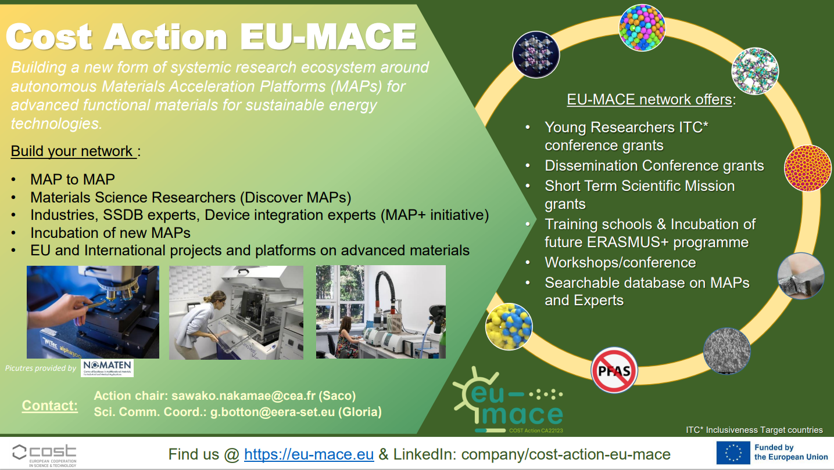
WG2 (complex alloys) update: Jaroslaw/NCBJ (PL)

Slide 26
Notes from discussion during the meeting
Increasing the involvement of YRIs: Creation of YOUNG EU-MACE task force (sub-group) to encourage YRIs to network, for example through organizing a workshop (could be a session during the MC meeting)
Enhancing Industrial involvement:
Prepare a model ‘advert’ to be used for introducing EU-MACE to potential industrial partners. (background: some members are contacted by industries for their technical expertise. It would be useful to have a flyer, or even a short example message that they can include in their correspondences for disseminating our Action. The potential industrial members can be solicited to give a talk at one of our meetings/workshops/schools, or sponsor our event)
Create: Network for business model for accelerated device development for industries. (background: Devices have many complex components that are intricately connected to one another. Developing such structures is beyond the technical capacity of a single industry. Industries can connect with EU-MACE members’ MAPs, labs offering off-line (from MAP) characterizations, and the knowledge on agent creation for setting up new device developments.
Funding opportunities:
Bespoke ‘network creation’ with orchestrating agent is constitutes a new project requiring funding (cannot fund within EU-MACE). But our Action can act as an incubator
EU program scouting for suitable calls: business model network for industries; legacy labs; infrastructure project, etc. This may be done within each WG.

Slide 27
Additional details on presentation items
About the online, bi-monthly webinar (Each WG is represented every 6 months)
The webinar should be scientific and rotate among WGs ➔ to be named “coffee with EU-MACE”
YRIs within or outside of Action can be invited
Should further discuss
Who invites and how to choose topics?
Format example: 1 presentation (45”) + discussion (15”)
Industries can also be invited
Topic ideas (should correspond to Action objective: building materials ecosystem/entire value chain)
Science: technical & research challenges in alloys, perovskites … new materials
Gaps: between different stages of value chains
How to accelerate materials research on alloys, perovskites, new materials; e.g., How to incorporate ML into traditional research, step-by-step guide toward automated and autonomous research design.

Slide 28
1st AAC summary

Slide 29
1st annual Action conference
September 4-6, 2024 @Uni. Cyprus (L.O. = Theodora Kyratsi)
Day 1: CG/MC meeting (16/29 countries) + WG3 workshop (17 in-person attendees)
Day 2: WG1 MAP presentation + International networking (21 in-person & +100 online)
Day 3: WG2 MAP presentation + round-table discussion (17 in-person & +40 online)
MC meeting minutes distributed among MC members
https://filesender.renater.fr/?s=download&token=203c0cc7-ba2a-4244-a0cc-1a6a8761349e

Slide 30
1st annual Action conference: WG3 workshop
TDM workshop (K. Malek) on 3 materials selected via online meetings and suggestions by members
Solid electrolyte polymers (A. Szawiola)
MOFs (D. Kriechbaumer)
No-PFAS (K. Malek)
TDM template per material class containing – Technology description/technical targets @material, components, unit and system levels)
Worked on « Technology description » in groups to define promising applications
Core groups formed to fill in the TDM template
Solid electrolyte polymers (A. Szawiola + A. P. Sanjuan + S. Nakamae)
MOFs (D. Kriechbaumer + O. Ozcan + A. Occhicone)
No-PFAS (K. Malek + M. Fabrizio + T. Inan)

Slide 31
1st annual Action conference: WG3 workshop
Next steps
Selection of applications (2 app’s/material class)
another round of online session with core group
Distribution to WG3 and Action with an explanatory message, include:
Construct core WG members
Set timeline
Complete the TDM analysis in GP2
Produce « position paper » for building MAPs for the selected material class (for specific applications in mind)
Interested? Contact: Saco, Kourosh, Anjuli and Dorottya
Some of you will be contacted by us.

Slide 32
1st annual Action conference: WG1 session
MAP presentations
Leah Nuss, TUM (in person)
Stefan Edinger, AIT (online)
Alexander Colsmann, KIT (online)
Gun Deniz Akkoc, FZJ (online)
Simon Stier, Fraunhofer Society (online)
Sebastian Siol, EMPA (online)
Presentations 3 through 6 are recorded ➔ being cleaned
Presentation 1 : file provided
Presentation 2 : file to be provided (need to ask)

Slide 33
1st ann. Act. conf: International networking
Organization/program/network presented
Sawako NAKAMAE, COST Action EU-MACE (in person)
Prof. Kevin Rossi, COST Action: DAEMON (in person)
Prof. Roberto Iglesias, COST Action: EU-MINE (online)
Dr. Anna Maria Christoforou, Cyprus/EU representative (in person)
Prof. Jasna Jankovich, REACH2 : H2 MAP network, USA (online)
Dr. Fanny Balbaud – DIADEM, France (online)
Prof. Venizelos Efthymiou, EU RI project: RISEnergy (in person)
Dr. Massimo Celino, IEMAP, Italy (online)
Dr. Lorenzo Malerba – CONNECT-NM (online)
Dr. Francesco Matteucci - EIC & IAM4EU co-programme
All presentations recorded ➔ under cleaning

Slide 34
1st annual Action conference: WG2 session
MAP presentations
Dr. Fanny Balbaud – A-DREAM/DIAMS, CEA (online)
Prof. Katerina Christofidou – Henry Royce Institute (recording) + Dr. Richard Dawidek
Dr. Janne Pakarinen - VTT (online)
Dr. Özlem Özcan Sandikcioglu - BAM (online)
Dr. Jaroslaw Jasinski – NOMATEN, NCBJ (in person)
All presentations recorded ➔ being cleaned
MAPs accepting STSMs

Slide 35
1st annual Action conference: round table
What actions for EU-MACE in GP 2?
Online webinars combined with monthly update meeting (every other month) ➔ see p. 28 for more details
More technic-focused online workshop
Improve - Industrial involvement (will require the members’ contribution) ➔ survey on who has contacts with which industries?
Proposition for training school co-organization (with CONNECT-NM, for example 2026)
Other networking models, e.g., organization of online workshop for students
Add Equipment mapping to the MAP/Expert list
Future LabLive participation (member MAP/Lab/project promotion) ➔ MC e-vote validated
Promotional video making (member MAP/Lab/project promotion)
Future projects (infrastructure, legacy labs, etc.) discussion
How to spend more money quickly?

Slide 36
To new members: at the monthly update meeting …
Overview of the current status of EU-MACE
Different Tasks in progress
Action immediate needs and how you can contribute!
Upcoming actions
How you can contribute and whom to contact
AOB of relevance

